Slide 1



Big Data Project
BUAN 6346
ANT Fleet Risk Analytics: Data Driven Approach to Driver Compliance and Safety Management
Group 5:
Nidhi Agarwal
Geetanjali Tomar
Praful Patil
Sahejbir Singh Kumar
Rajavardhan Reddy Singireddy

Slide 2
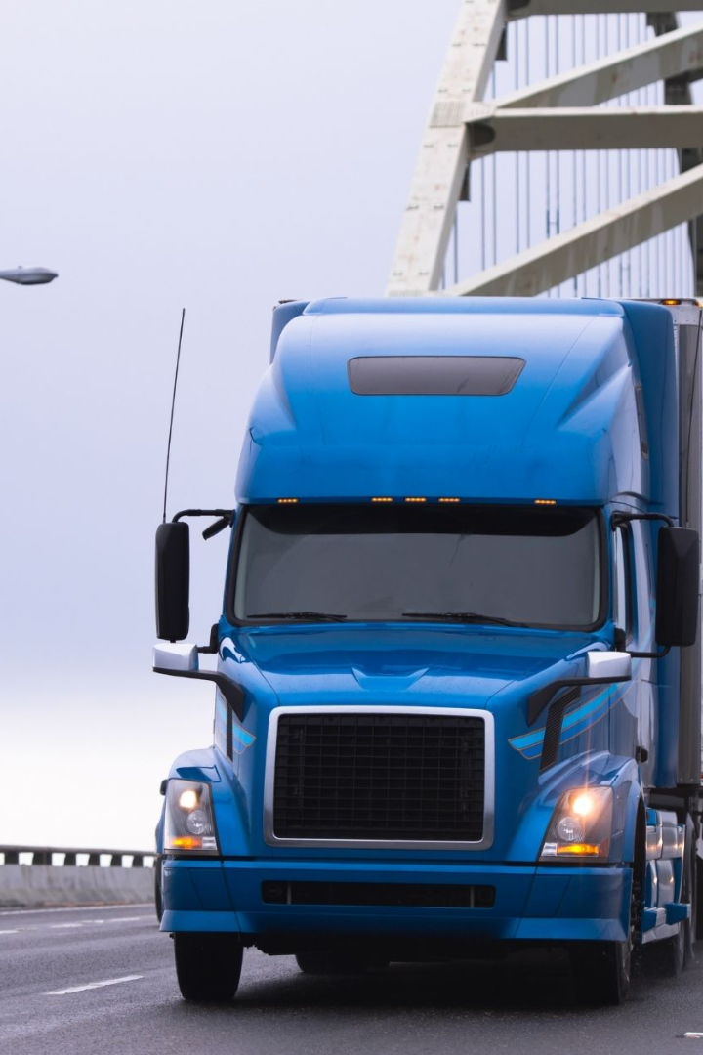
Problem Statement and Objective
At Az National Trucking(ANT), ensuring all drivers follow safety and regulatory rules is a tough task. Certain risk factors like mileage, speed, and compliance with laws often exceed safe levels, leading to a high risk of insurance issues.
Our main goal is to create a system that can easily spot drivers who have a 'Mileage/Speed' risk score of 7.0 or more. Ultimately, we aim to increase safety, cut down on insurance risks, and improve the efficiency of our fleet.

Slide 3






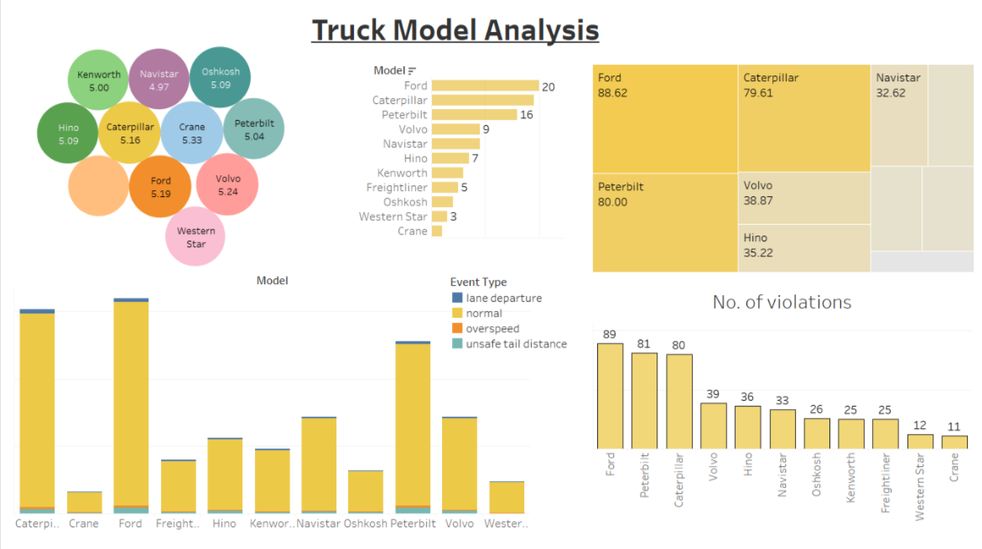



Process Workflow
Create tables
(geolocation,
trucks, and
trucks_mg)
Connect to
Tableau server
Used scp to
Connection using ODBC drivers for Impala
to move data to home/training
in hive and load data using LOAD DATA INPATH
for visualizations
Load data into HDFS
Integrate Tableau with RStudio using Rserve
Download and move data
to Cloudera image
Created visualizations
in Tableau

Slide 4
DATA PREPRATION
riskfactor
geolocation
driver_milage
trucks
trucks_milage
avg_milage
trucks_mg
RISK FACTOR CALCULATION:
RISK FACTOR = (sum of event/total no. of miles)*1000000
RISK FACTOR(SCALED) = (RISK FACTOR/15.5709) * 10

Slide 5
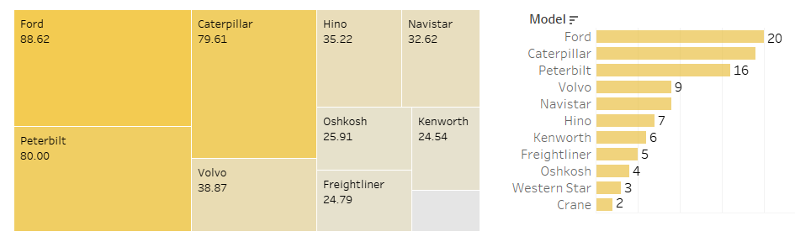
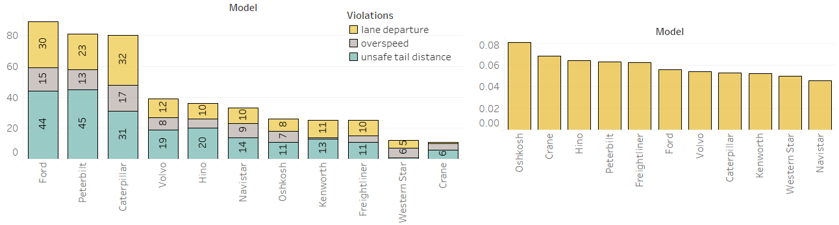
RISK FACTOR ANALYSIS BY TRUCK MODEL
Ford, Caterpillar, and Peterbilt are the top three truck models used.
Ford, Caterpillar, and Peterbilt are the top three riskiest trucks as well in terms of no. of violations reported, let’s investigate further.
Most common type of violations are lane departure, and unsafe tail distance.
If we look in totality, Oshkosh reported the highest percentage of violation events w.r.t all the events recorded for that model.
Without additional data about trucks such as safety features available, can’t comment much.
Driver’s can be educated about the safe tail distance, and lane departure rules.

Slide 6
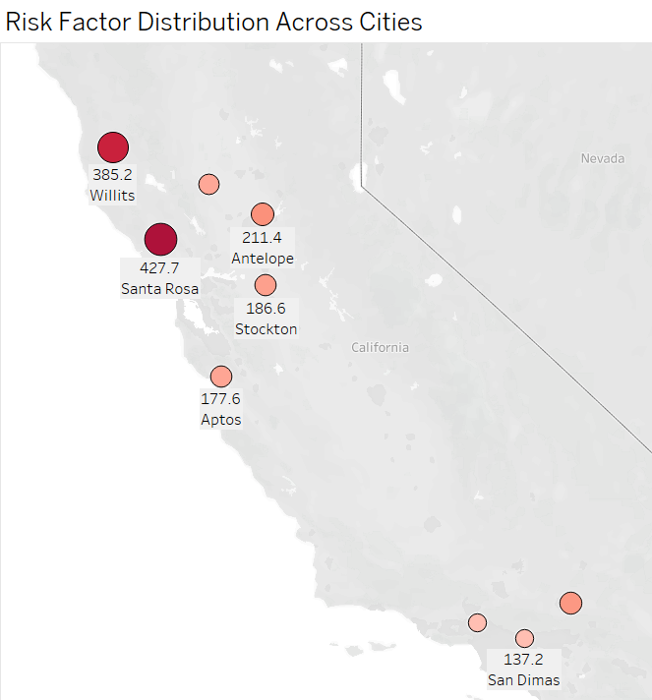
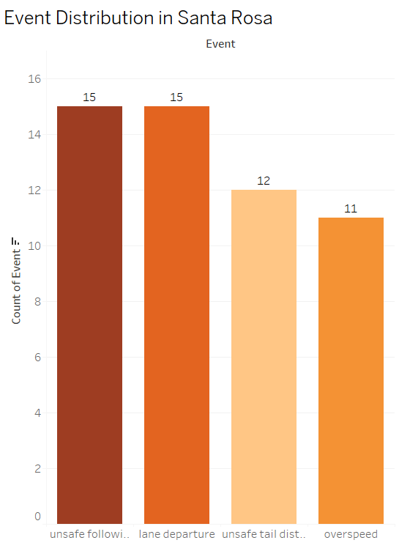
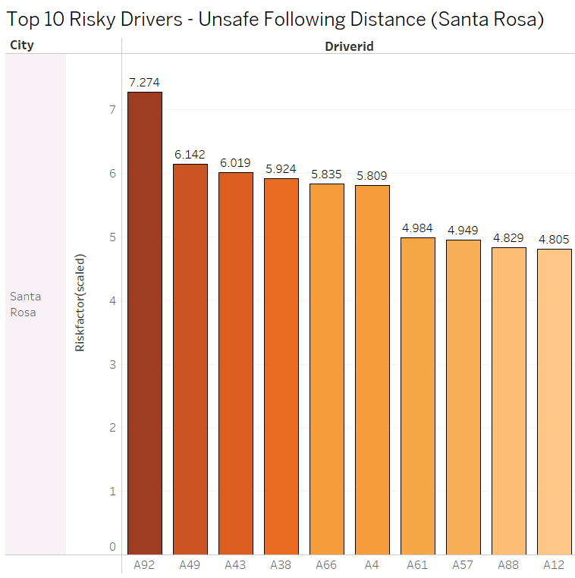
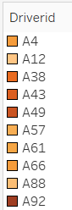
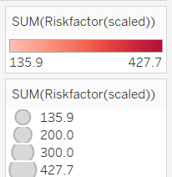
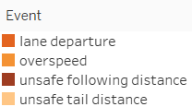
High Risk Analysis By City
Santa Rosa has the highest risk factor among the cities compared
The cities with the next highest risk factors are Willits, Antelope, Apple Valley, and Stockton
Distribution of Event in Santa Rosa City
Lane departures: 15
Over speeding: 11
Unsafe following distances: 15
Unsafe tailgating: 12
Santa Rosa city
Top-10 Driver IDs
Highest occurrences of unsafe following distance
Riskiest driver: A92

Slide 7
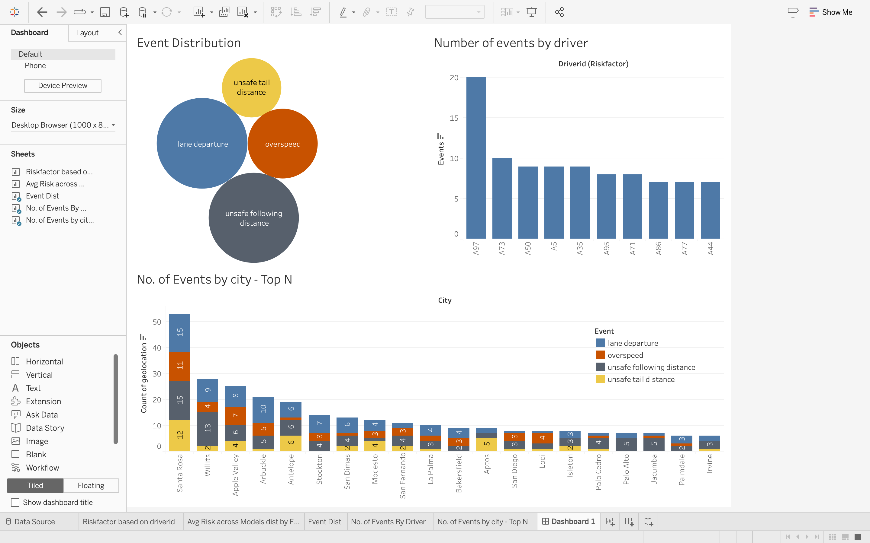

Event Distribution
Most Number of Events: Lane departure
Least Number of Events: Unsafe Tail Distance
A97 seems to be the riskiest driver followed by A73.
Santa Rosa has the highest number of events with lane departure and unsafe following distance being the most.
Unsafe following distance seems to be the highest in most of the Top 10 cities.

Slide 8
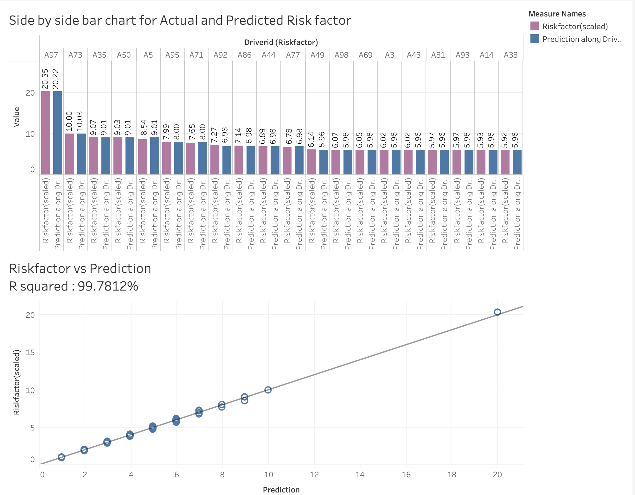
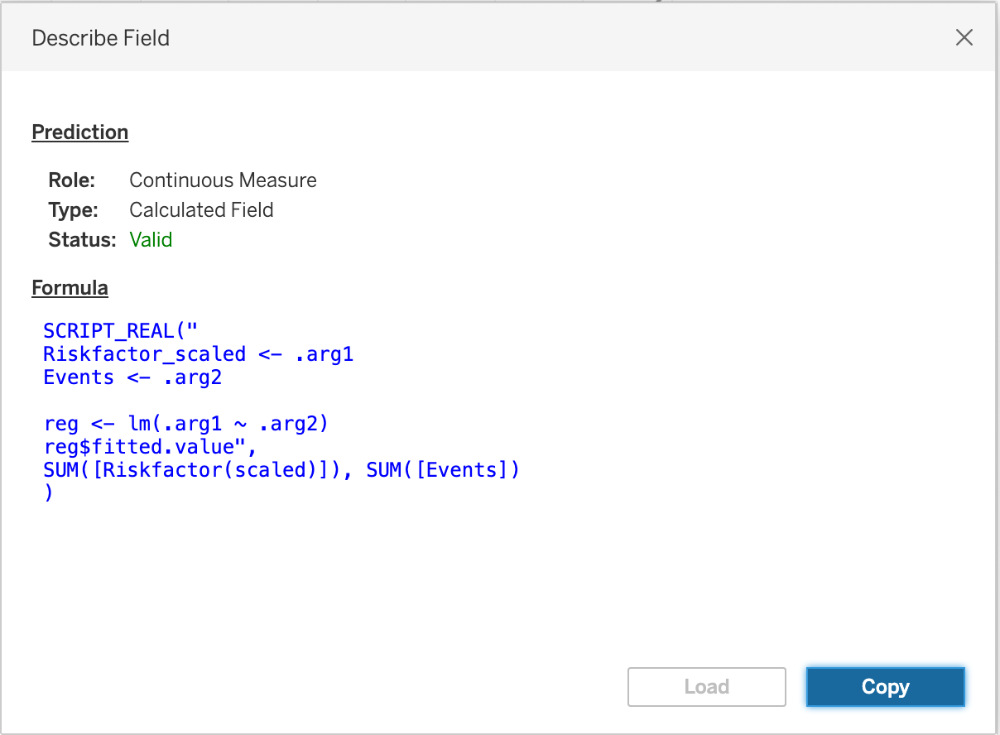
Comparing Actual and
Predicted Risk Factor
The Prediction has the R Squared value of 99.7812% which means its an excellent fit
Therefore we can use this model to predict Riskfactor of drivers in unseen dataset

Slide 9

Conclusion and Future Scope
We have identified that:
A97 is driver having highest risk factor.
Most number of events occur in Santa Rosa, A92 being the riskiest driver in the city. Lane Departures and Unsafe following distances are the most common occurring events in the city.
“Unsafe Tail Distance” is the least caused event, while unsafe following distance seems to be the most common event in top 10 cities.
Ford, Caterpillar, and Peterbilt are the most used trucks among all and the analysis show that they are the riskiest in terms of number of violations reported. But when all events are taken in totality, Oshkosh reported the highest percentage of violation events.
ANT needs to throw light on implementing safety measures to reduce risks related to A97 and addressing common issues like Lane Departures and Unsafe Following Distances in high-risk cities like Santa Rosa, while also improving safety standards for popular truck models like Ford, Caterpillar, Peterbilt, and Oshkosh in the industry

Slide 10


